Slide 1

Shark Ninjas
Group Members:
1. Aagam Sanjay Shah (8935540)
2. Arun Natarajan (8949959)
3. Gurjant Gir (8879347)
4. Pournami Jaya Prakash (8939749)
5. Rahul Rajan (8913186)

Slide 2
SaveYou Inc. Introduction
SaveYou Inc. is a new company focused on providing cyber insurance, consultation services, and solutions for companies and individuals.
The company has experienced a huge surge in business since the start of the pandemic.
Expertie of the company is to provide security from identify theft and ransomware attacks and provide solutions to them.
The company is expanding offices in Germany and Singapore and, in the future, in South America.

Slide 3
Business Requirement
1. Secure Access
VPN - Introducing Virtual Private Network (VPN) integration for all mobile applications that access corporate resources and data. Through data encryption, VPNs protect users utilizing public Wi-Fi networks from prying eyes
App Whitelisting: The likelihood of an attack can be decreased by restricting the use of mobile devices to pre-approved business applications.
Biometric Authentication: use strong passwords and pins for business app logins in addition to fingerprint and face recognition technologies for device unlocking.
Session Timeout: By setting a time limit for each session and having apps automatically log out after a while of inactivity, it reduces the chance of unauthorized access occurring if your device is left unattended

Slide 4
Business Requirement
2. Robust Security
Jailbreak/Rootkit Detection: introducing techniques to identify devices that have been rooted or jailbroken in order to prevent possible security breaches.
Application Sandboxing: To reduce the effect of potential malware infections, use application sandboxing to segregate business apps from the underlying device operating system.

Slide 5
Business Requirement
Disaster Recovery and Residency
Disaster recovery through redundant architecture and backup systems
MDM/MAM should be in a geographically distributed cloud platform that adhere data residency regulations.

Slide 6

Mobile Solution Design
How to secure data in motion?
Encrypting all data sent between corporate computers and mobile devices from beginning to end. This guarantees that even if it is intercepted, unauthorized persons cannot access the data.
How will you ensure security for data at rest?
→ Protect data stored in the app on the mobile device by using robust encryption methods. This keeps sensitive data safe if the device is lost or stolen.

Slide 7
Mobile Solution Design
What mobile devices will you allow?
→ Only devices approved by the company and adhering to strict security guidelines will be permitted by the organization. Regular security evaluations will be conducted to guarantee compliance.
What policies (restrictions) will you apply to those devices?
→Applying strict rules on the configurations and features allowed on devices. This ensures turning off functions like USB debugging, limiting the installation of apps from unidentified sources, and imposing passcode constraints on devices.

Slide 8

Allowing BYOD
BYOD encourages employees to utilize their or organization-provided devices to work; familiarity and personalization may increase productivity and be easy to use with employee availability
Using employees' personal devices can help organizations save money on device purchases and maintenance.
By allowing employees to bring their own devices, BYOD policies can improve participation and employee productivity

Slide 9
Why Allowing BYOD
BYOD has advantages, but there are security issues as well. To reduce these threats, the Organization will thus put strong security measures in place, such as containerization.
1
To implement security regulations and track compliance, employees who bring their own devices (BYOD) must consent to install the company's mobile device management (MDM) software.
2
The organization will hold frequent security training seminars to train employees on how to secure their personal gadgets when using company resources.
3

Slide 10

High availability and fault tolerance
How will you guarantee the service is always available?
Ensure hardware redundancy - Deploy infrastructure on multiple datacenters or cloud availability zones.
Distributing traffic - Implement load balancer to improve performance and prevent outage due to traffic.
Monitoring – Deploy tools that alerts service or server downtimes.

Slide 11
High availability and fault tolerance
How will you create a fault tolerant solution?
Building redundant mobile infrastructure – Each component must be redundant so that they can be switched over during failure.
Failover clusters – Automatically switch to redundant components during failure.
Caching and offline functionality –Cache stores data on local and offline functionality gets updated to database once connectivity is resolved.

Slide 12
High availability and fault tolerance
What components could fail, identify any SPOF’s
Datacenter or cloud provider – SPOF, if relies on single datacenter or cloud provider.
Security Attacks – Failure to servers or network devices.
Network Components – Devices such as switch, router can fail. SPOF, if devices are not redundant.

Slide 13
Disaster Recovery
What will you do in case of a major disaster (Disaster Recovery) :
Utilizing Redundancy – Redundant components in different regions can come online.
Disaster Recovery Plans – Identify disasters and document procedures and escalation matrix.
Backup Systems – Data recovery through backup devices.

Slide 14
Disaster Recovery
How will you account for major disasters such as natural disasters (flood, fire, storm), war, failing of electrical grid :
Natural disasters (flood, fire, storm).
Regional redundancy – Datacenters in different geographical area.
Site security measures – Site should be built in such a way that it is resistant from flood, fire, storm.
Backup Systems – Redundant backup systems in multiple regions can recover data.

Slide 15
Disaster Recovery
How will you account for major disasters such as natural disasters (flood, fire, storm), war, failing of electrical grid :
2. War –
Monitoring and control – Site should be guarded. Access restrictions to each person to the site.
Escalation – Involvement with law authorities.

Slide 16
Disaster Recovery
How will you account for major disasters such as natural disasters (flood, fire, storm), war, failing of electrical grid :
3. Failing of electrical grid –
Backup power units – Recovery through multiple power units.
Efficient methods – Technologies to detect interruptions.
Discrete power units – Main architecture components should have separate power units.

Slide 17





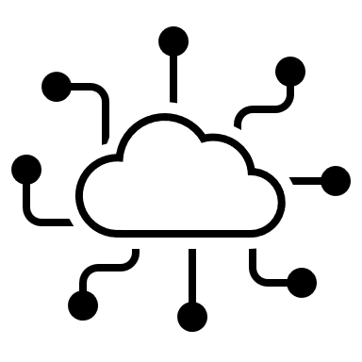

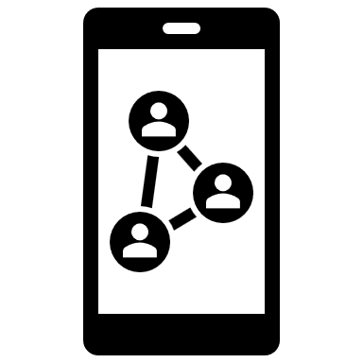

Global web
servers
VPN
IOS or android
devices
WIFI
Access point
MDM/MAM
Firewall
Cloud
Service
Global service
IOS or android
devices
Mobile networks
Content severs

Slide 18

This design prioritizes security and scalability for SaveYou's global workforce.
In accordance with data residency rules, the cloud-based
MDM/MAM platform with geographically spread servers enables safe mobile device management.
A simple login process is ensured by integration with local
IdPs, and multilanguage support serves the needs of an international workforce.
Information is protected both in transit and at rest with data encryption.
BYOD is supported with strict security policies enforced on authorized devices.
The cloud platform's high availability features ensure uninterrupted service.
A fault-tolerant solution is provided by the design, which addresses potential SPOFs through redundancy.

Slide 19

Any Questions?
-Thank You

